Slide 1

Machine Learning
Dr. Abbas Malekpour

Slide 2

Type of Variables

Slide 3
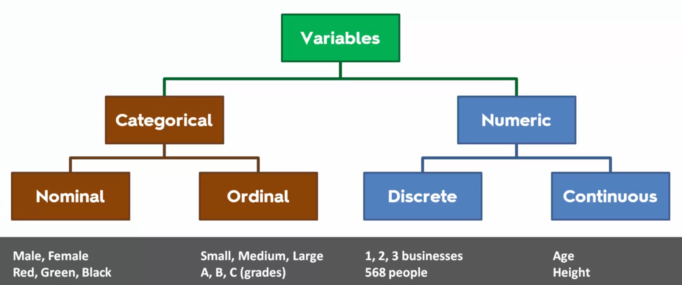
Type of Variables
Numerical and Categorical
Notes:
Target variable is Dependent Variable
All other features or variables are Independent variables

Slide 4
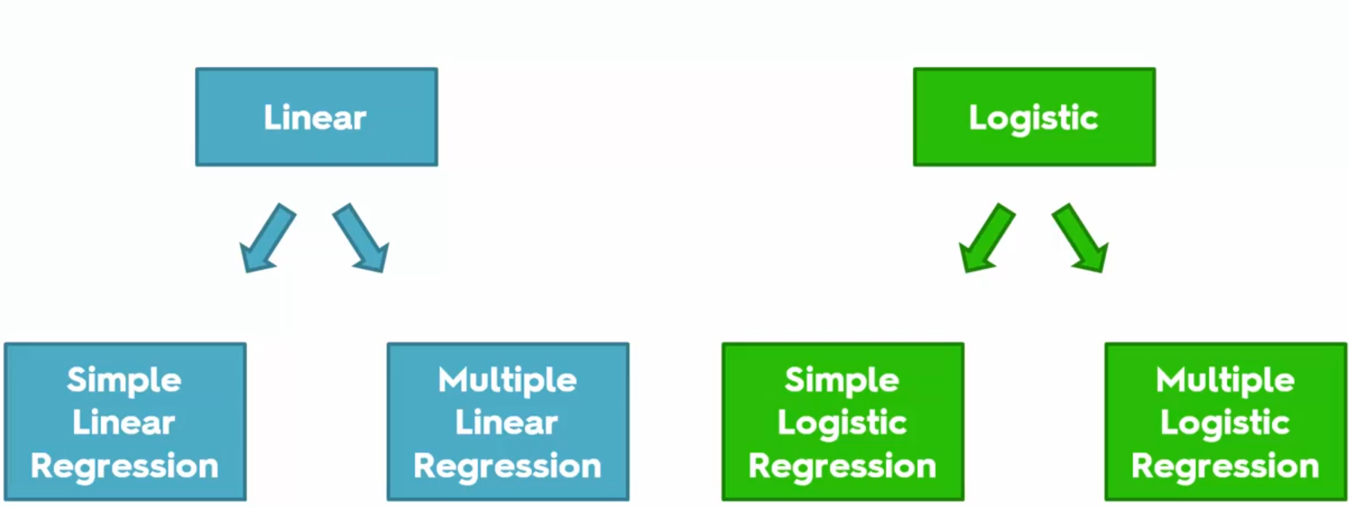
Regressions
Linear vs Logistic

Slide 6
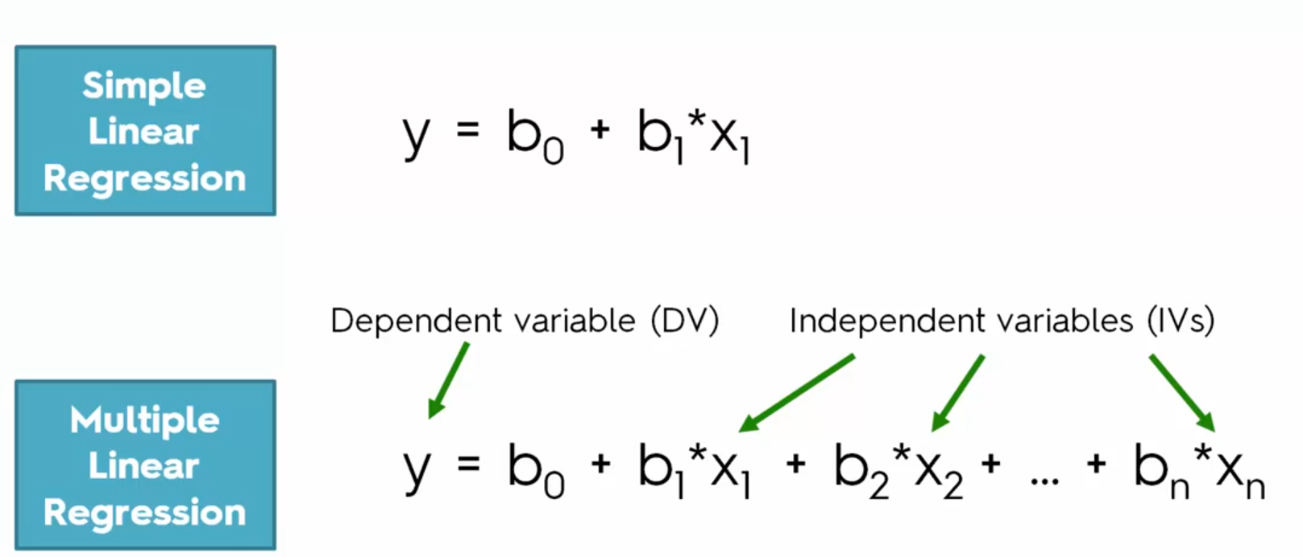
Equations
Simple vs Multiple Linear Regression

Slide 7
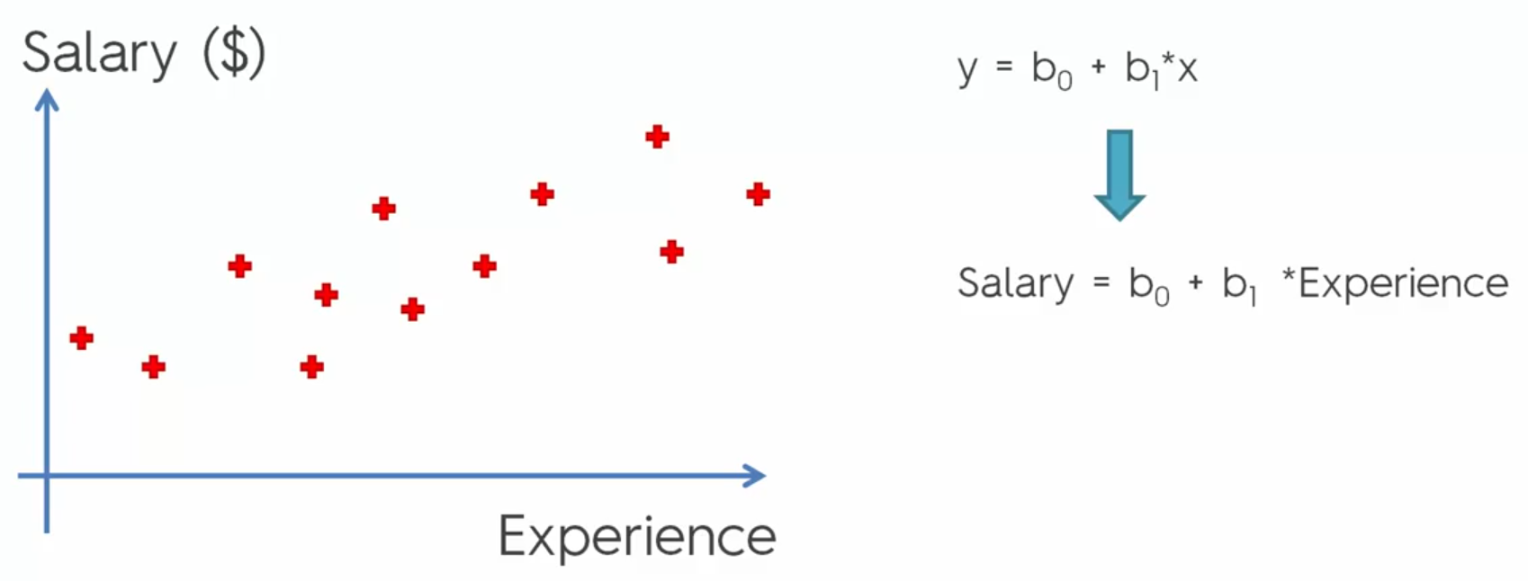
Simple Linear Regression
Salary and Experience

Slide 8
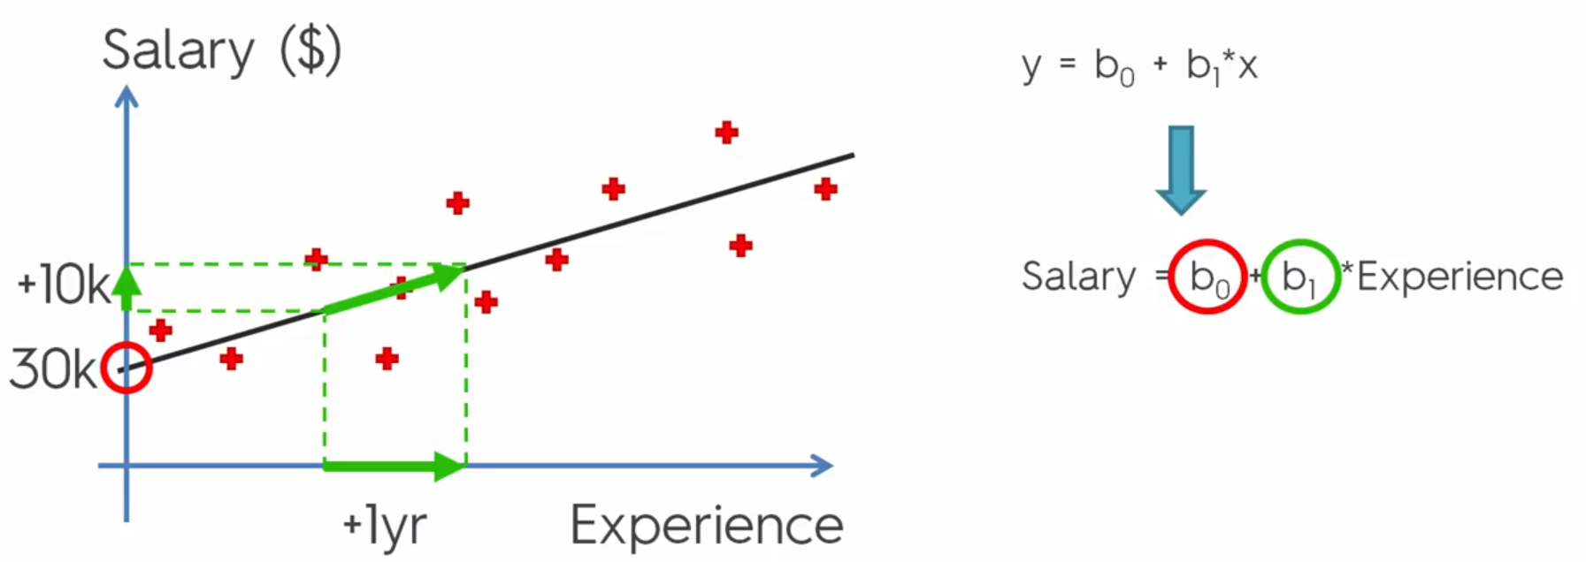
Simple Linear Regression – Continue
Linear Algebra
Notes:
B0 is Bias, B1 is the slop of the line

Slide 9
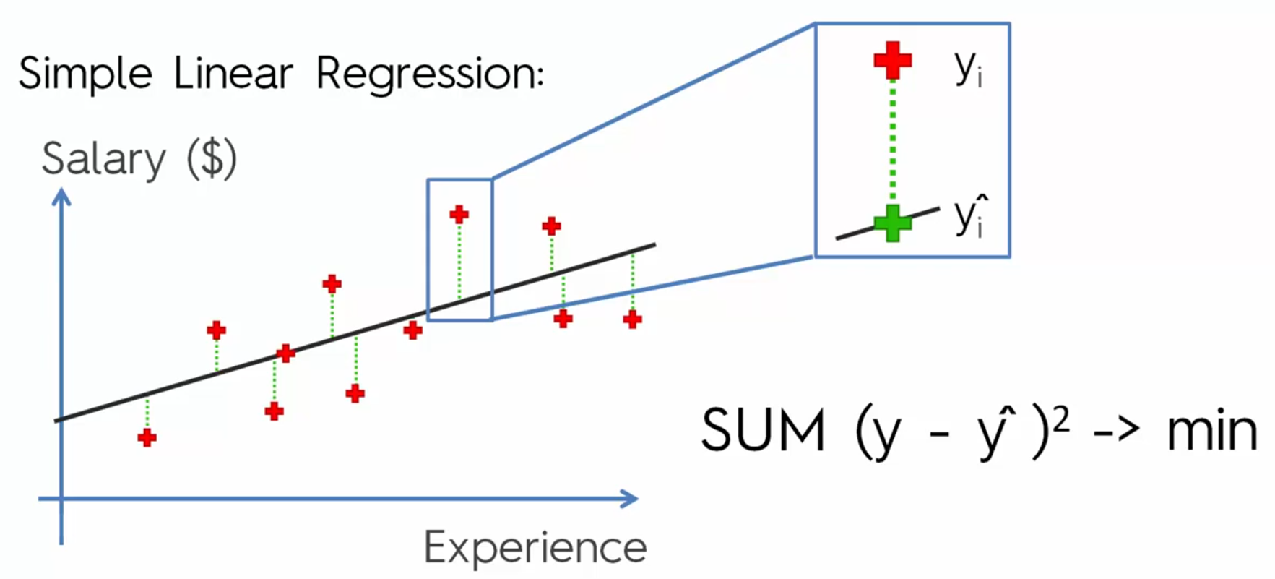
Ordinary Least Squares
Evaluation Models

Slide 10
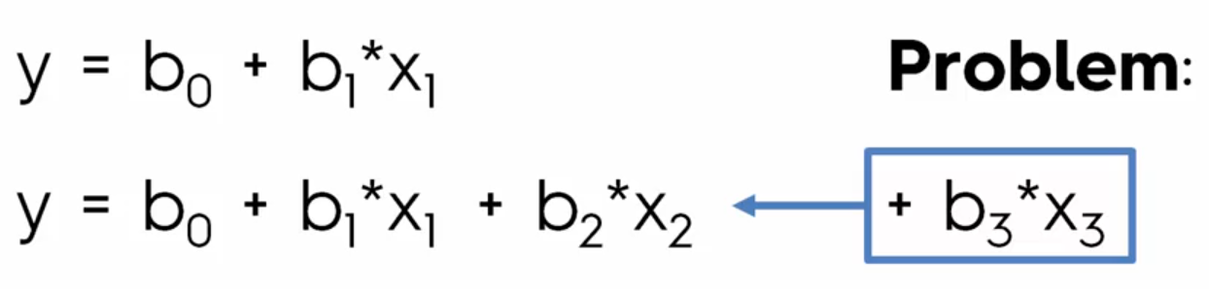
Adding Variable to reduce the ERROR rate
How many variable need to be added?

Slide 11
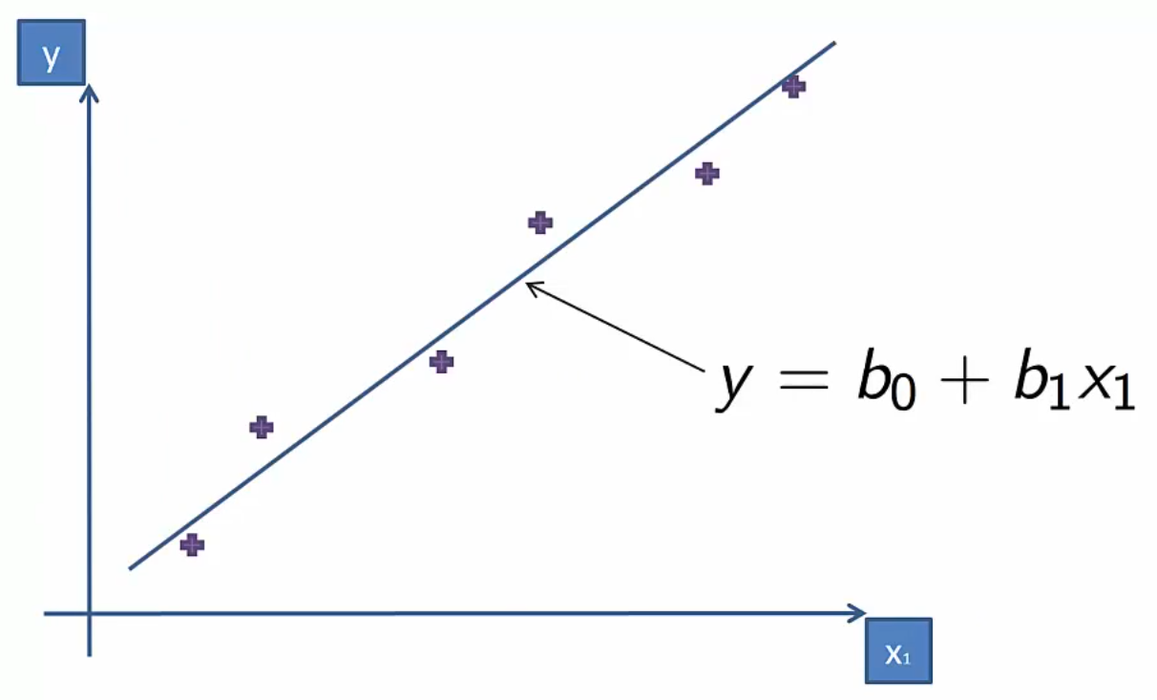
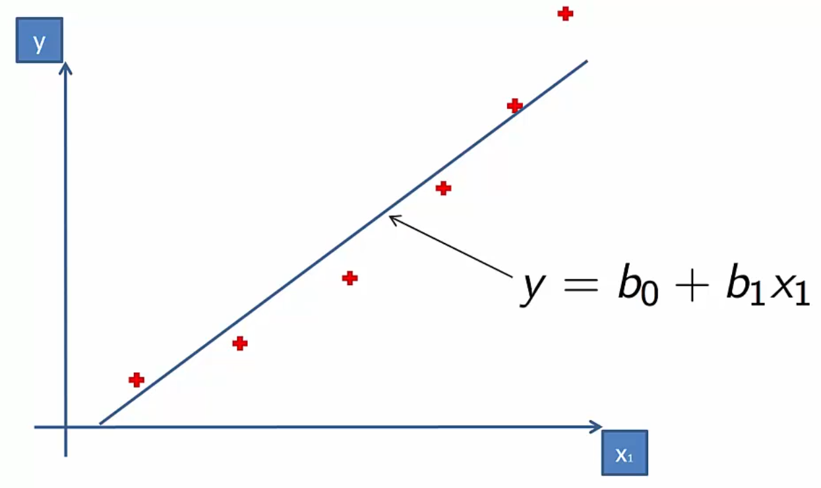
Notes:
Left fits well <> right does not fits well

Slide 12
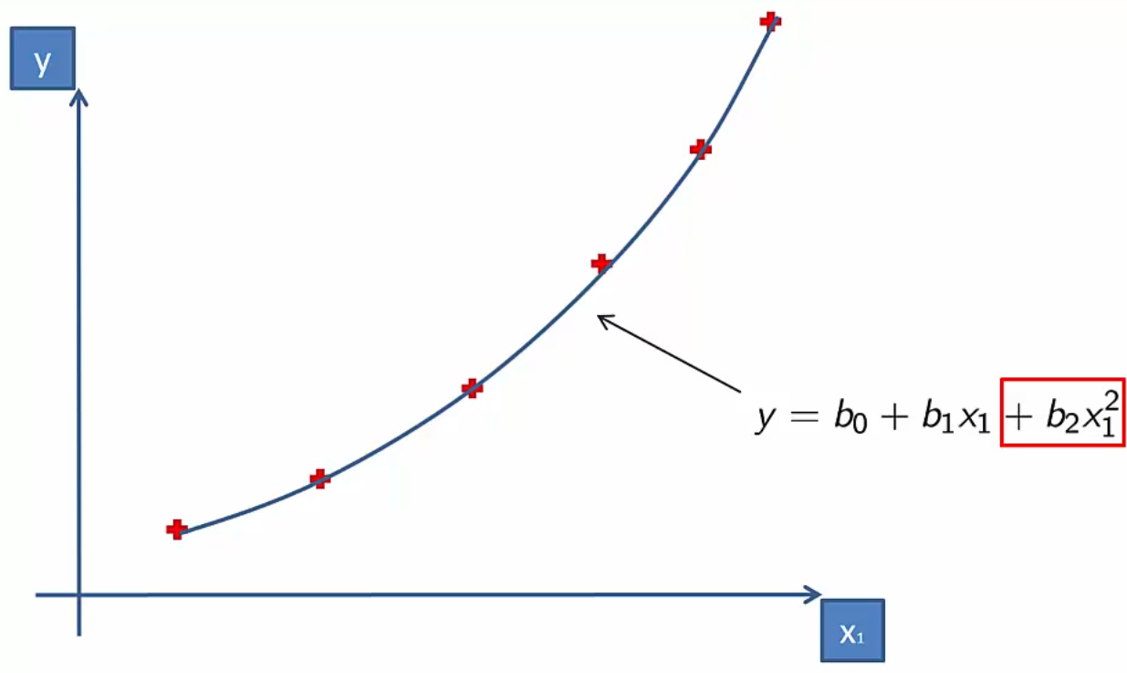
Why is called Linear?
Notes:
Coefficients are Linear!!

Slide 13
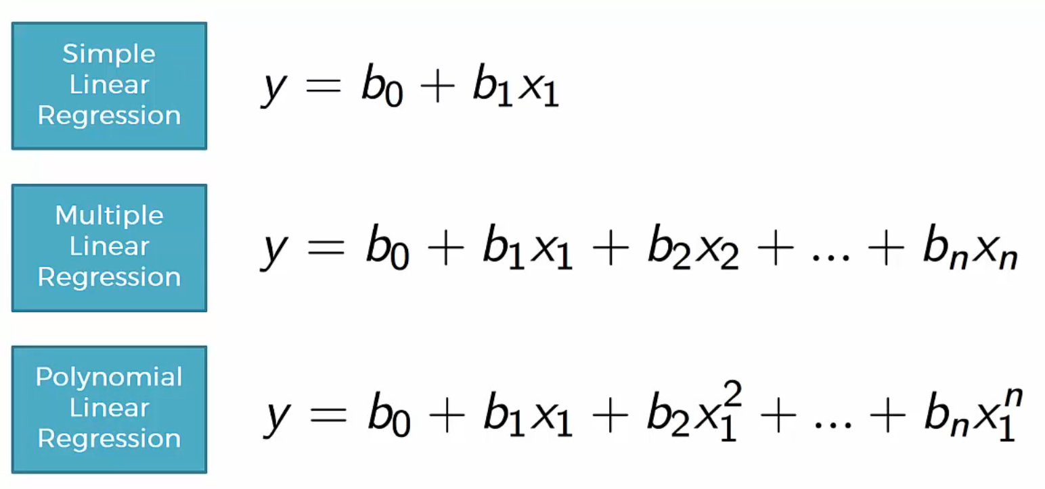
Single and Multi Variable vs Polynomial Linear Regression

Slide 14
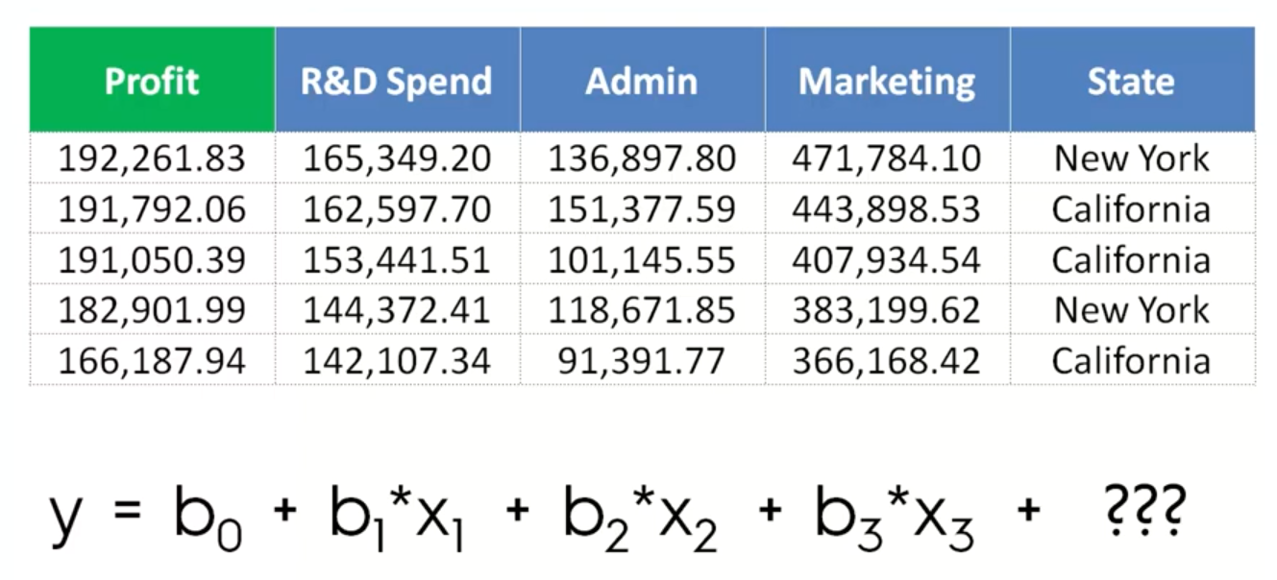

Slide 15
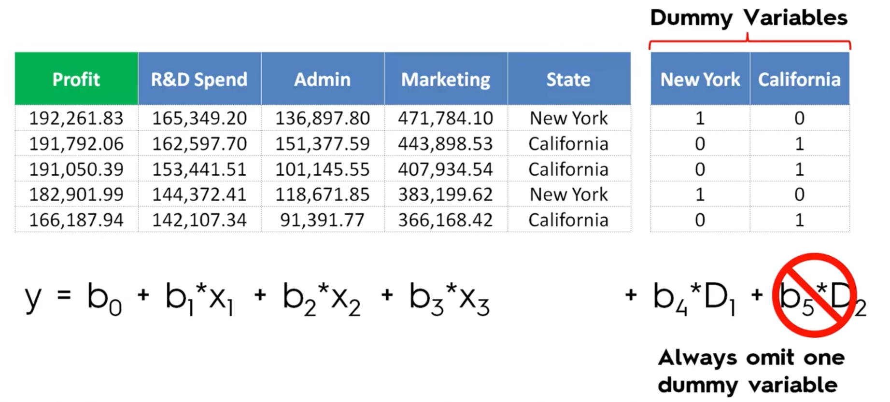
D1=1-D2 Multi-Colinearity

Slide 16
SVM – Support Vector Machine
Notes:
Non linear but continues model

Slide 18
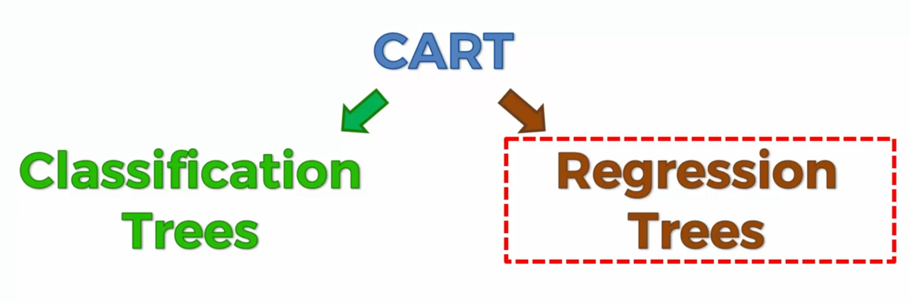
Classification and Regression Trees

Slide 19
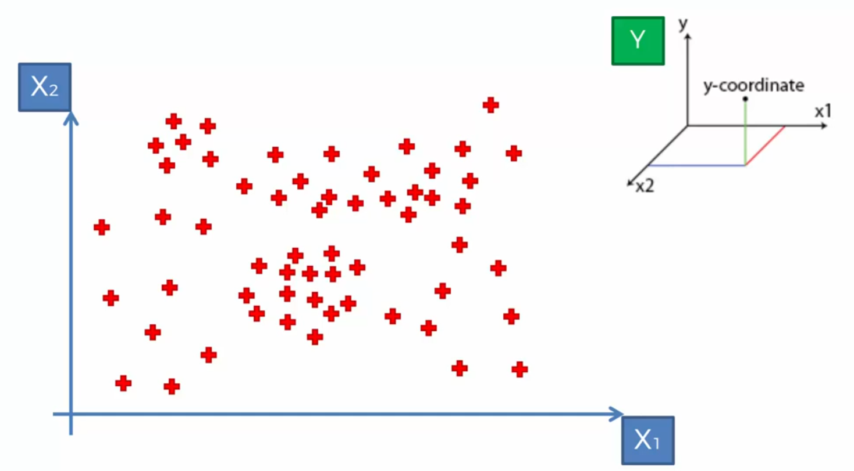
Decision Tree Intuition

Slide 20
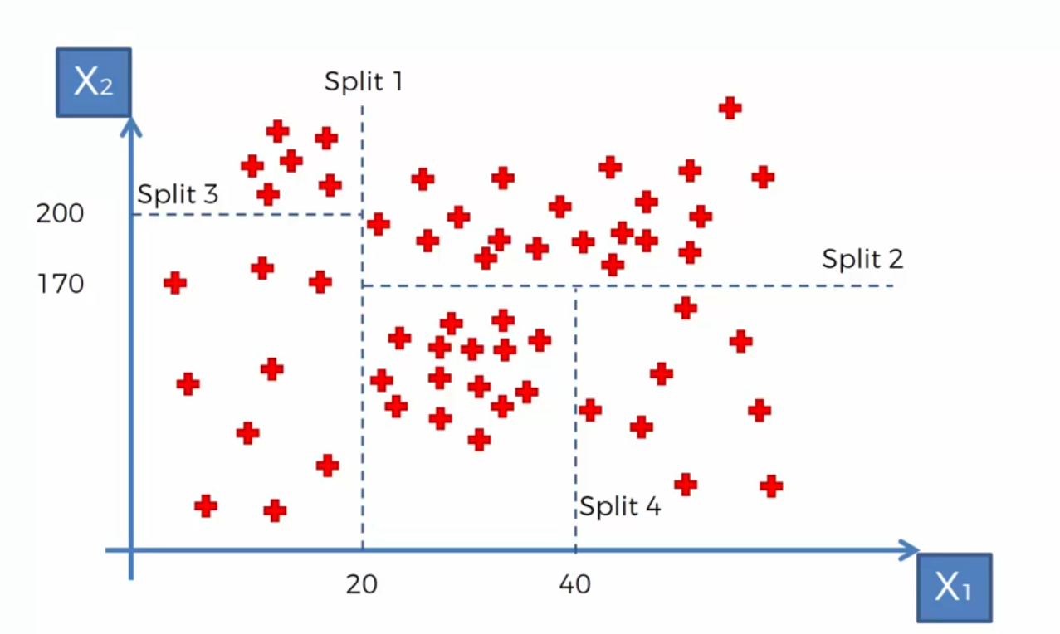
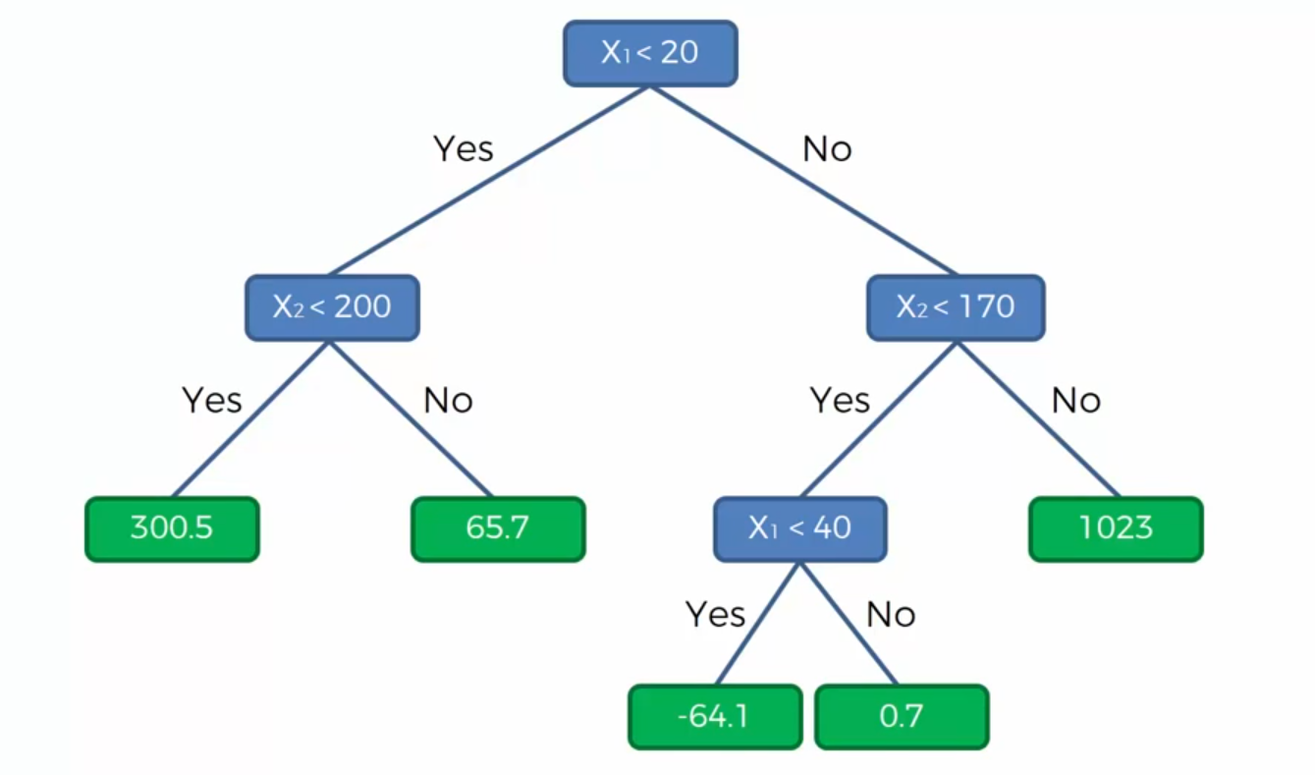
Notes:
Information Entropy… whether adding new split give us more info or not?

Slide 21
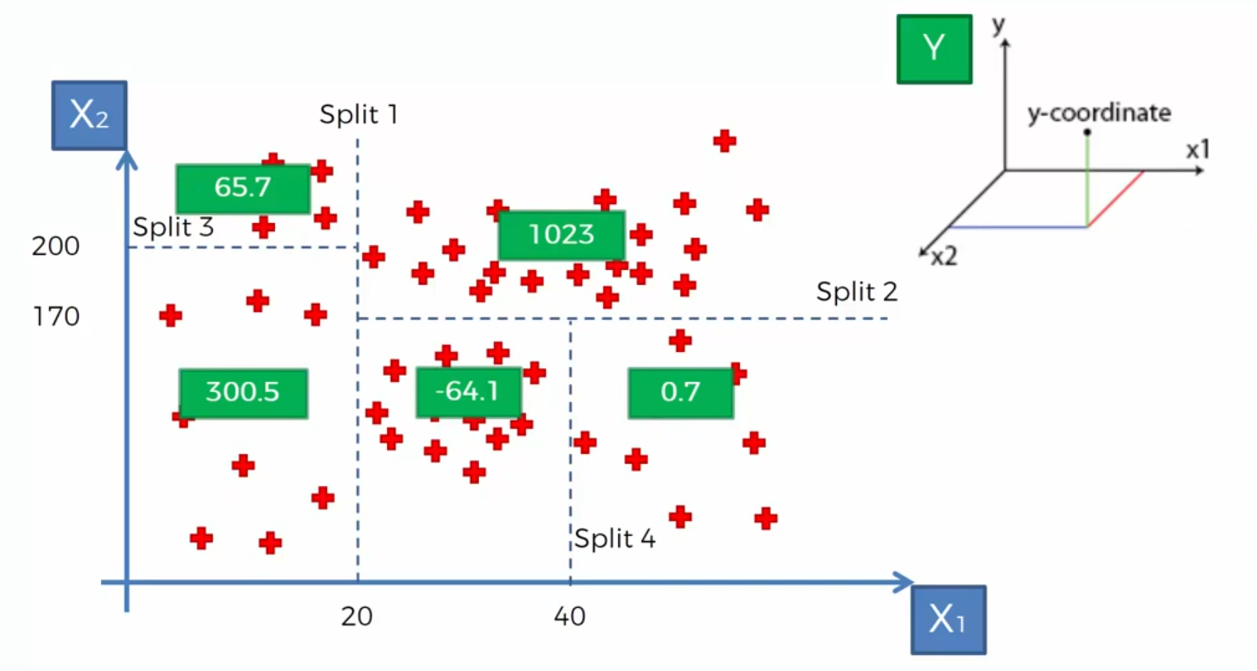
Decision Tree value for Regression models
Notes:
Non linear and not continues model

Slide 22
Decision Tree and Final output for Regression model
Notes:
Average of each partition will be the result of partition

Slide 23
Ensemble Learning
Bagging
Different independent sample
Random Forest
and for each sample you make a separate Decision Tree
Boosting
Weak learning
…

Slide 24
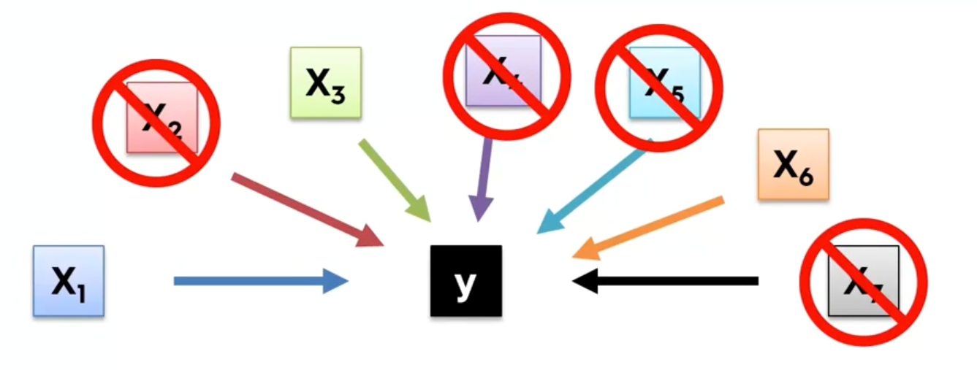
Building a Model
Why we don’t need to keep all columns?

Slide 25

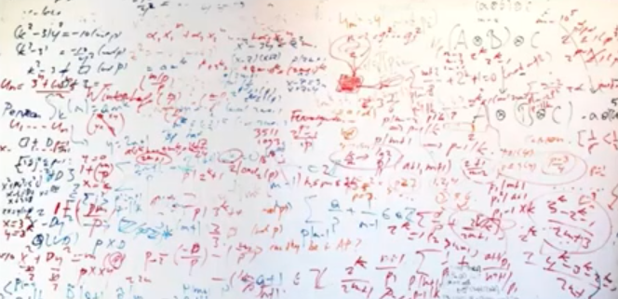
Building a Model
Why we don’t need all the Features?
Garbage in Garbage out
Complexity and confusion

Slide 26
Objectives and Overview
Predict the burned area of forest fires!
A reusable end-to-end Regression framework
EDA
Feature Selection
Feature Engineering
Training and Test Data selection
Modeling
Pipeline for each possible steps
Hyper Parameter Tuning
Evaluation

Slide 27
Classification

Slide 28
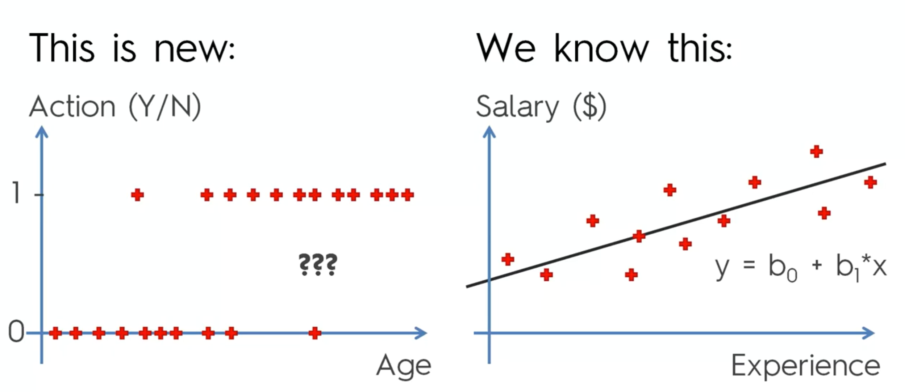
Classification

Slide 29
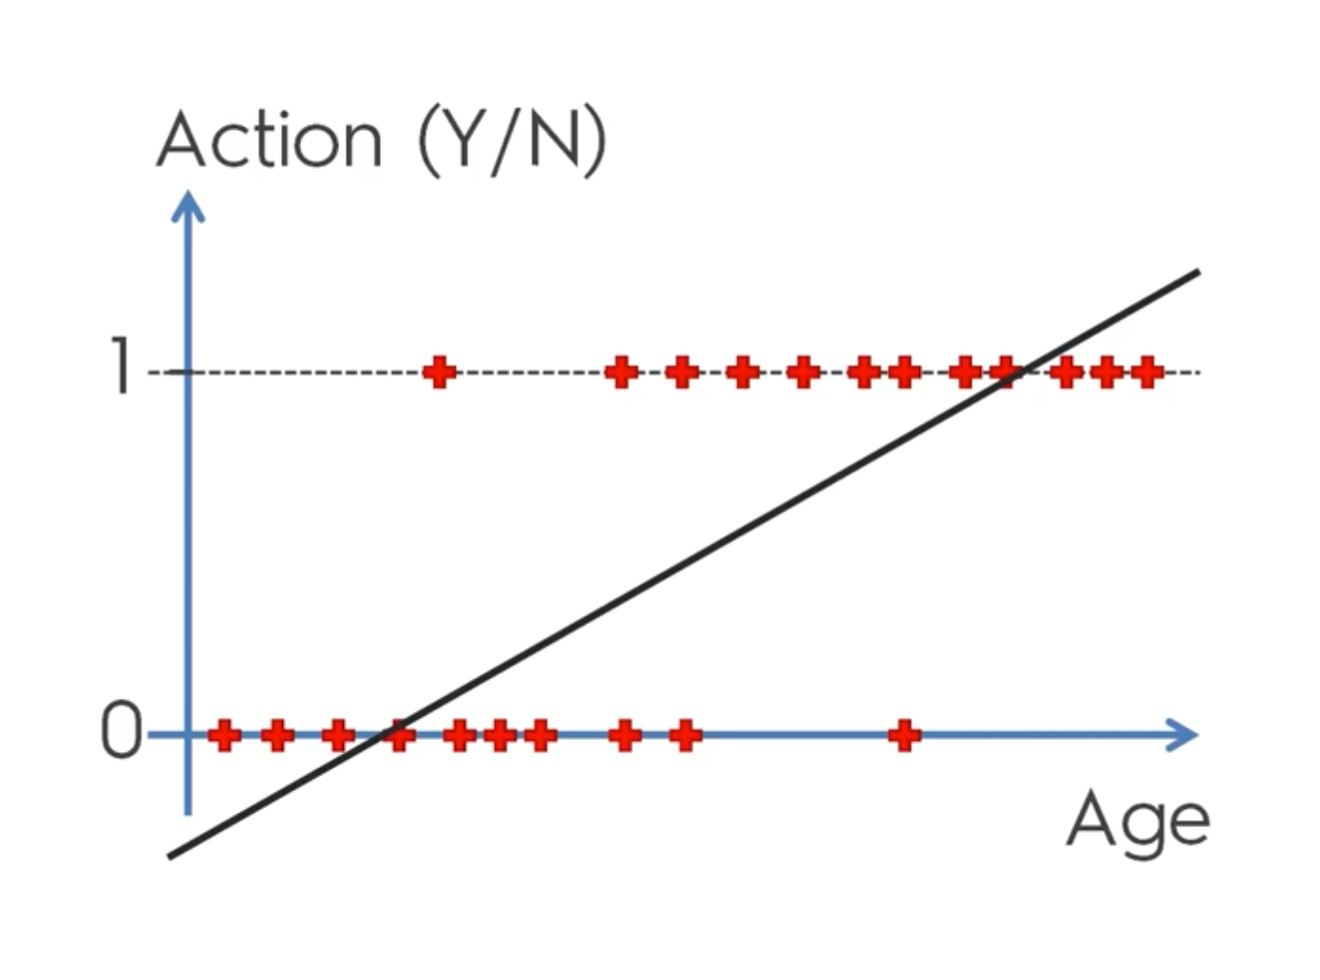

Slide 30
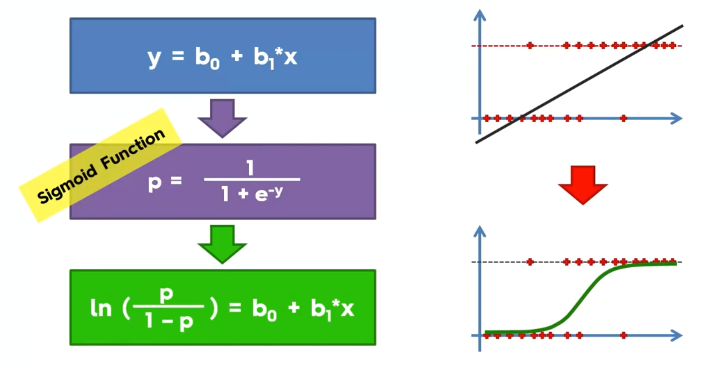
Notes:
Forget this for learning

Slide 31
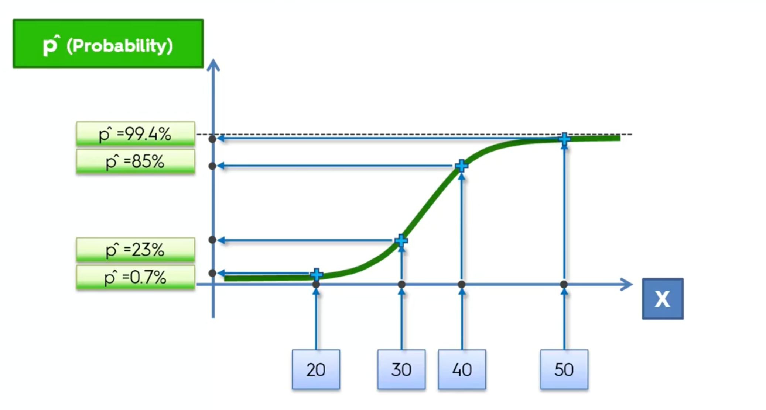

Slide 32
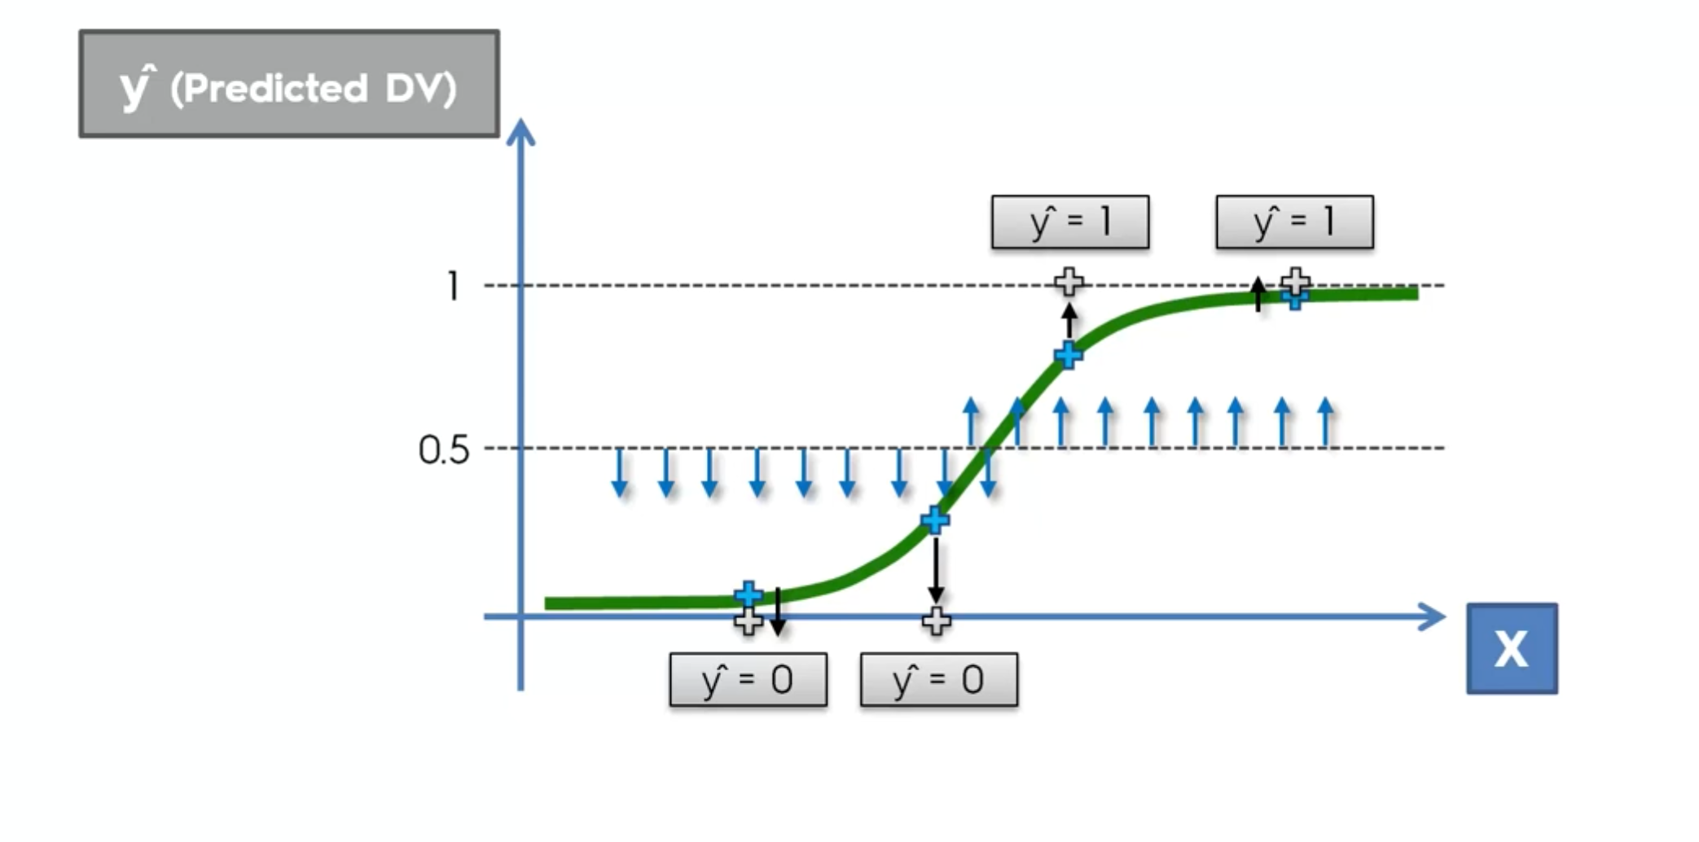

Slide 33
K-Nearest Neighbor
Choose the number K of neighbors
Take the K nearest neighbors of the new data point, according to the Euclidean distance
Among these K neighbors, count the number of data points in each category
Assign the new data pint to the category where you counted the most neighbors
Your Model is ready
Notes:
Default is 5

Slide 34
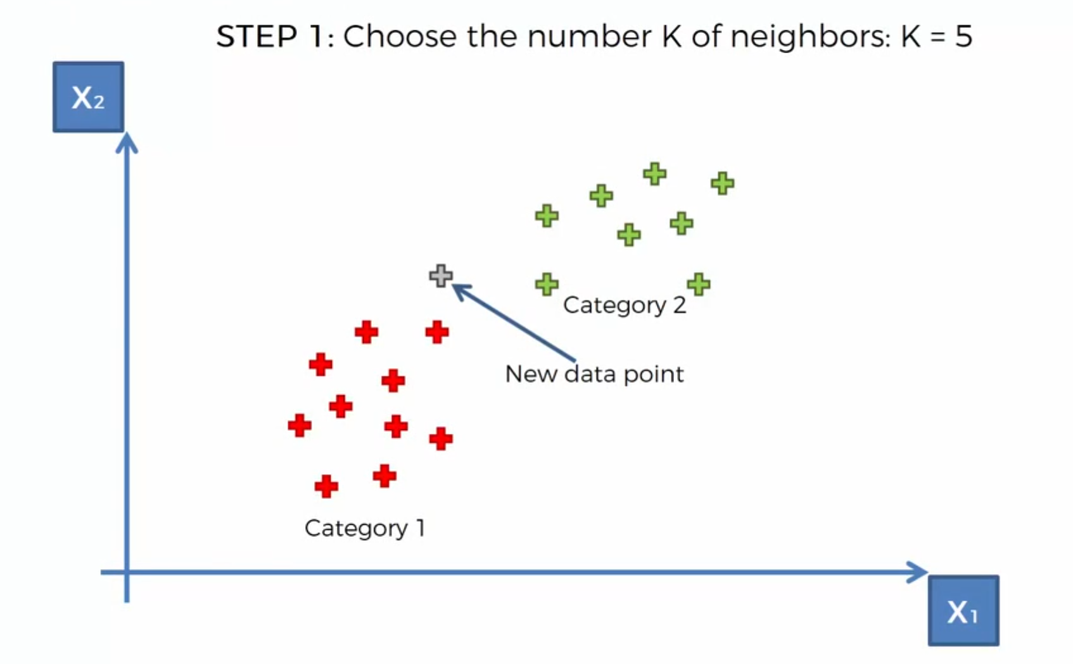
K-NN

Slide 35
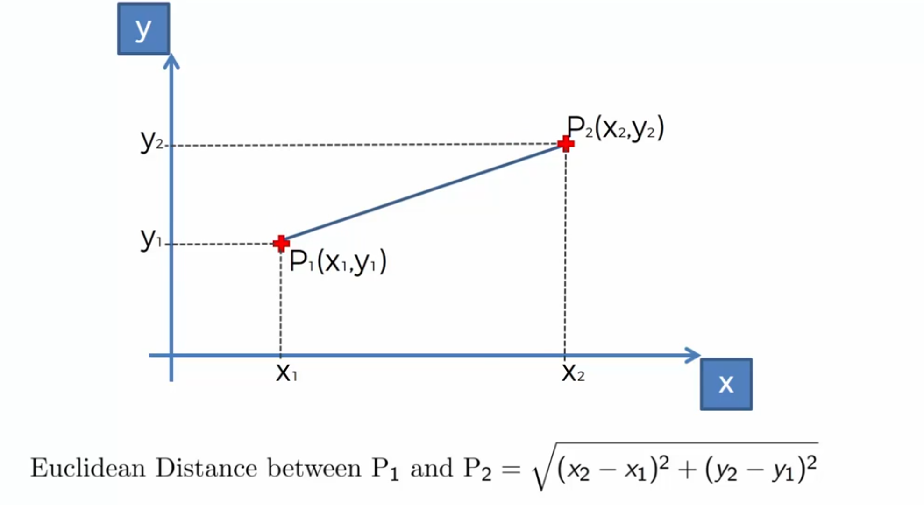

Slide 36
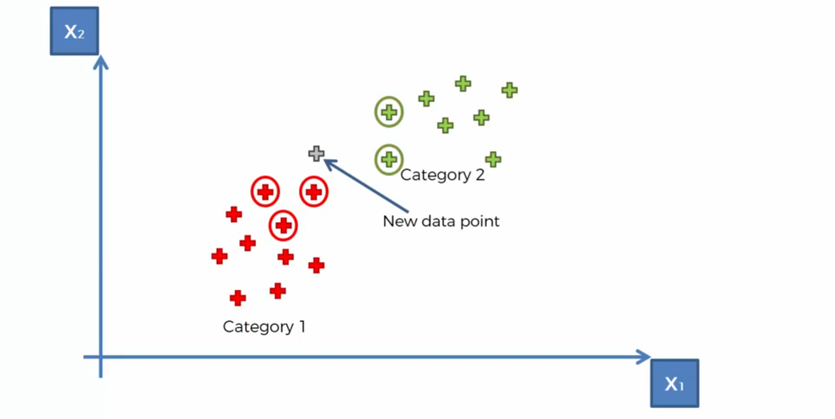
K-NN

Slide 37
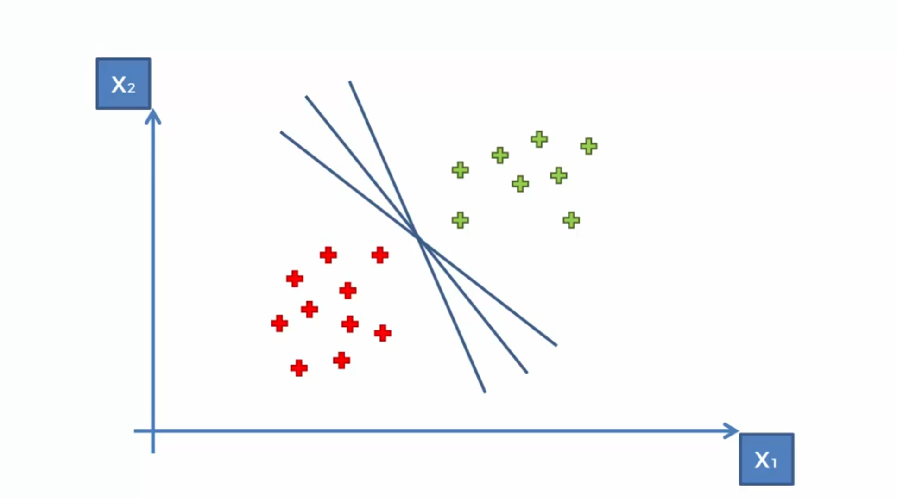
Support Vector Machine (SVM)

Slide 38
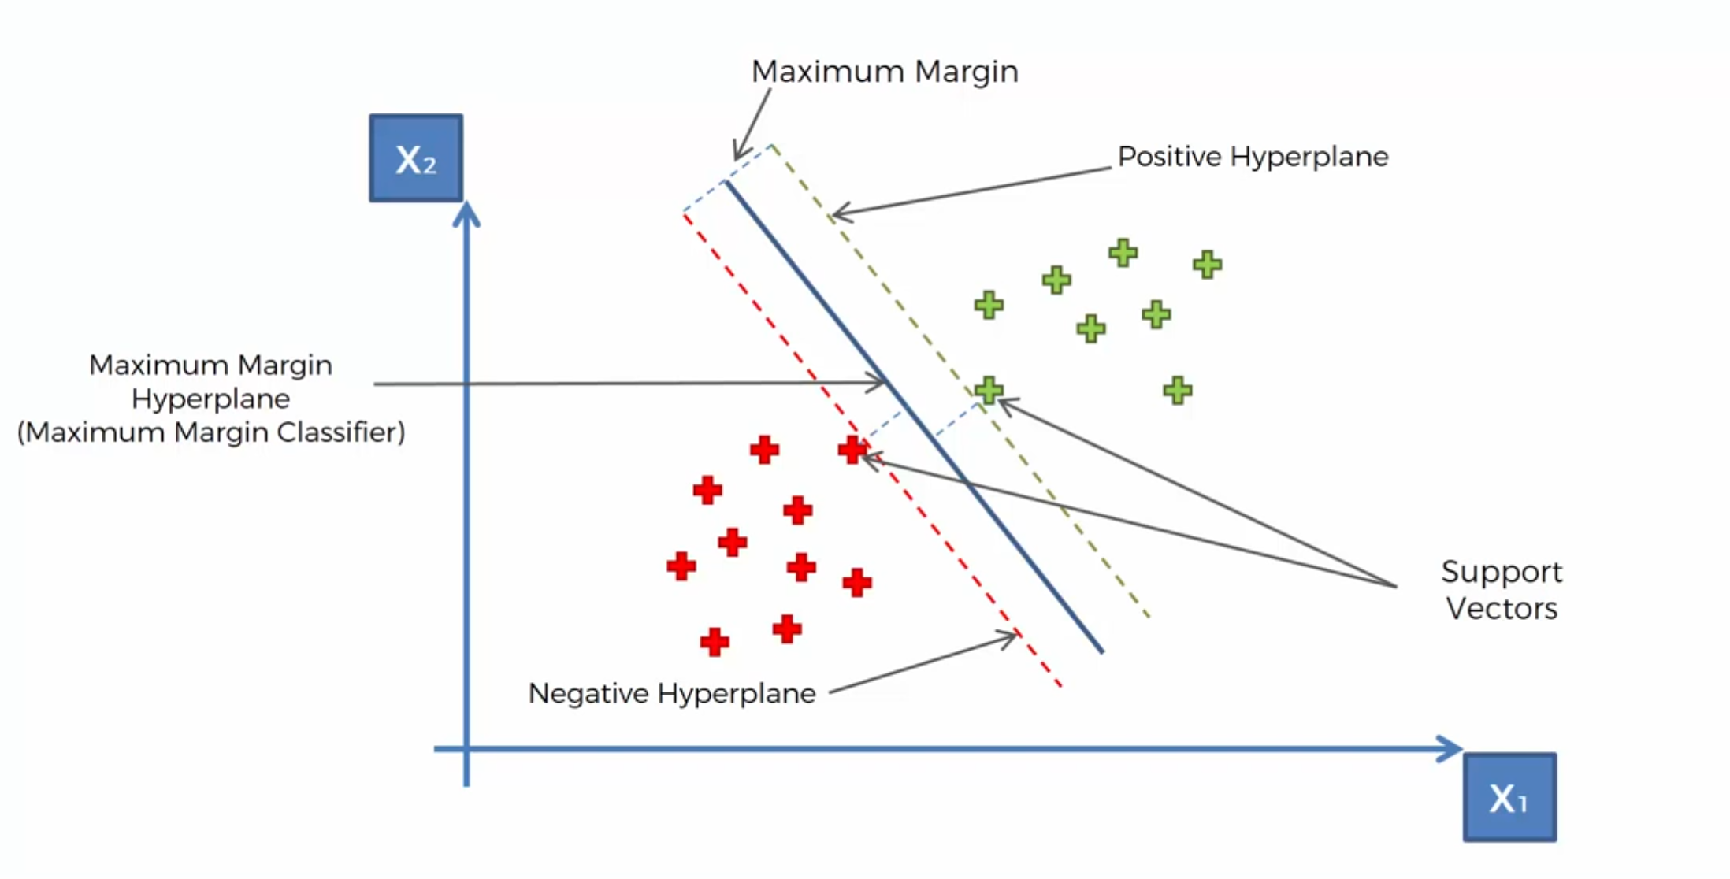
SVM

Slide 39

SVM

Slide 40
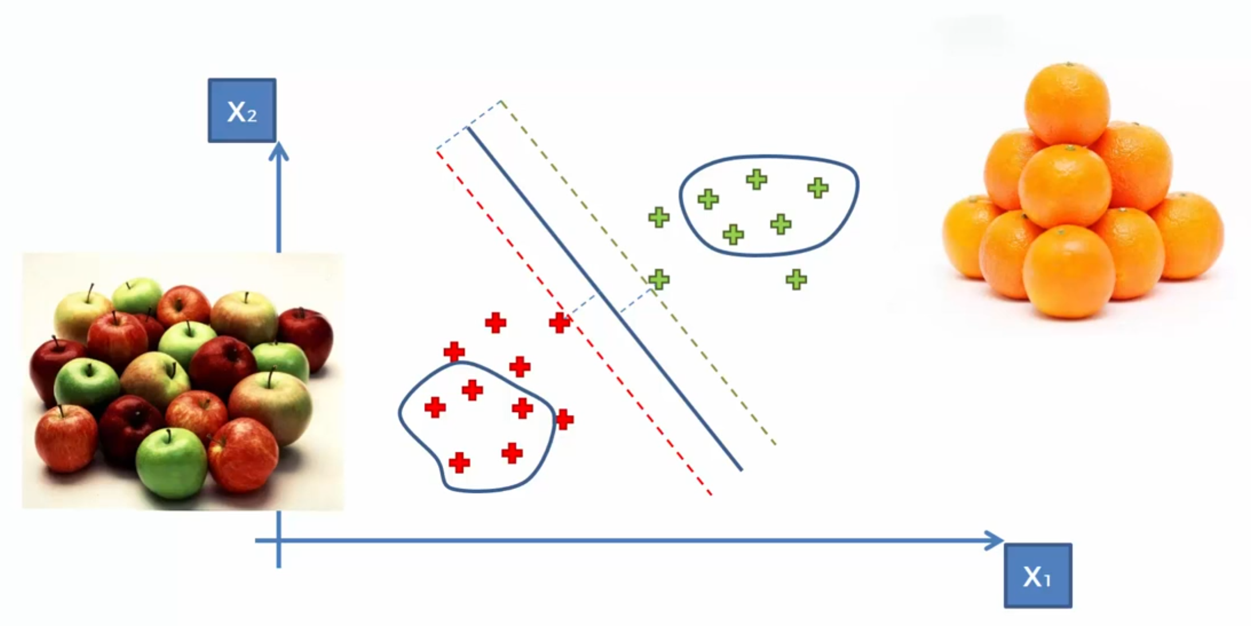
Most of the other ML models

Slide 41
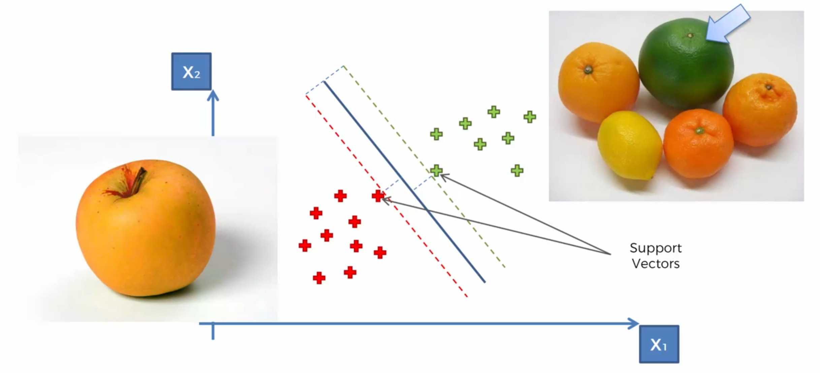
What is so special about SVMs?

Slide 42


Thank You
Abbas Malekpour
Abbas.malekpour@gmail.com

